Slide 1
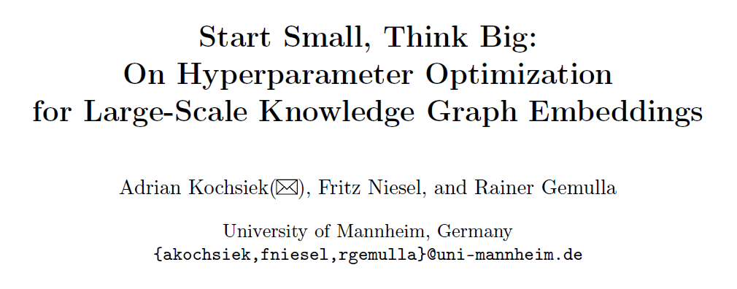
Haobo Xu
2022/7/27

Slide 2
Outlines
Multi-arm Bandit Problem
Framework
Background
Motivation
Method
KGTuner
Experiments
Kochsiek A. et al."Start Small, Think Big: On HPO for Large-Scale KGEs" ECML-PKDD 2022

Slide 3

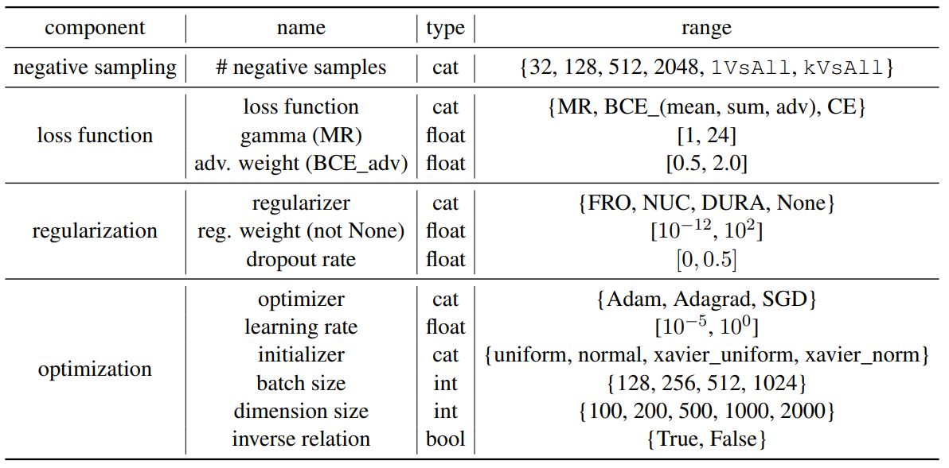
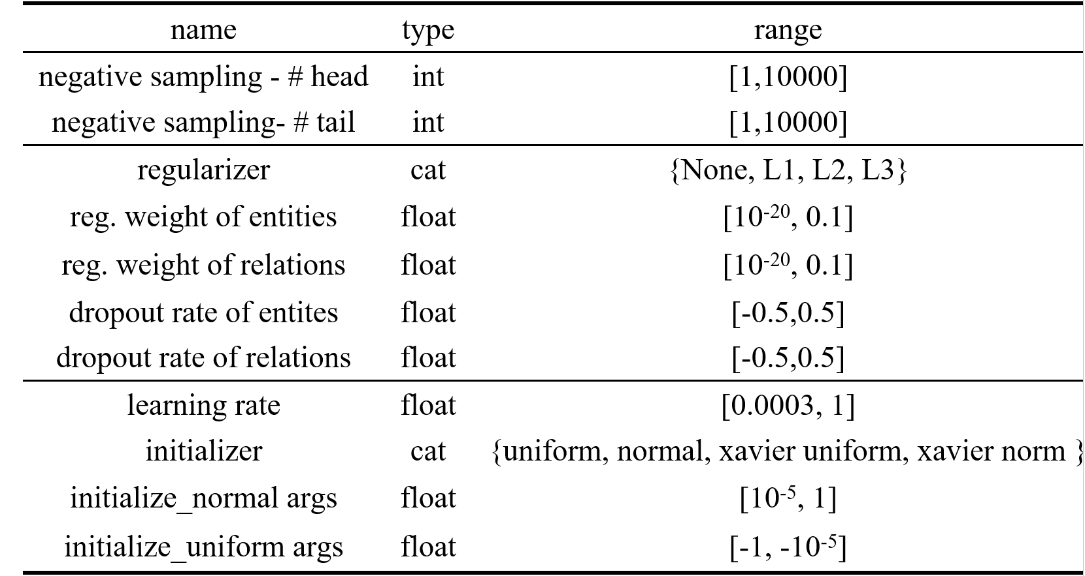
Background
Hyperparameter (HP)
Hyperparameter Optimization (HPO)
Criteria of HPO
Anytime performance
Search Space
KGTuner
GraSH

Slide 4
Background
Full-fidelity HPO vs Low-fidelity HPO
low fidelity:
A common technique to speed up tuning is therefore to probe an algorithm/hyperparameter configuration on a small subset of the data, by training it only for a few iterations, by running it on a subset of features…
——Frank Hutter. Hyperparameter optimization
 | Full-fidelity HPO | Low-fidelity HPO
Description | many epochs & full graph | epoch reduction / graph reduction
Cons | high quality results | low quality results
Pros | high computational cost | low computational cost

Slide 5
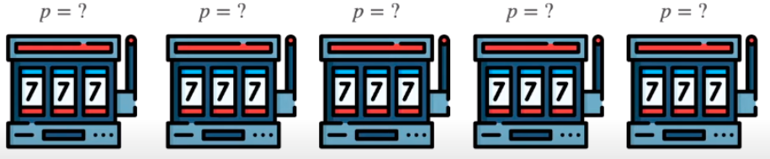
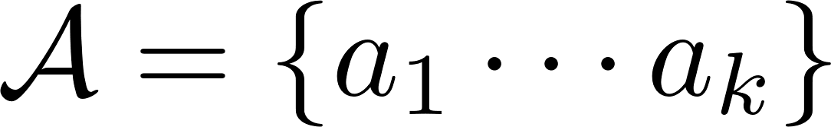

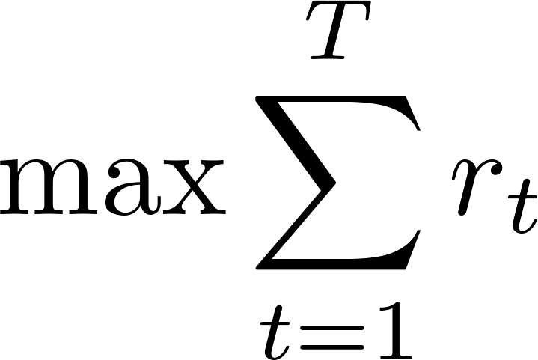
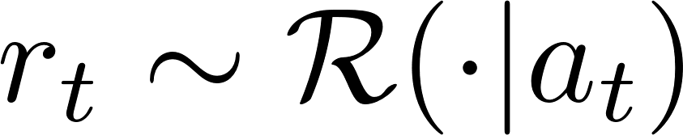

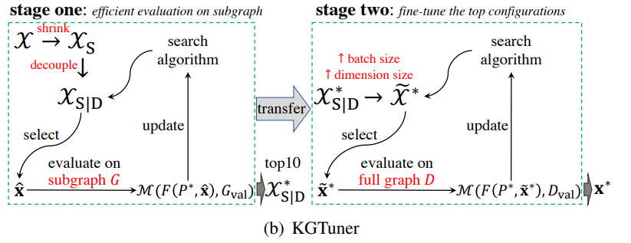
Background
Multi-arm Bandit Problem
, where denotes playing
the i-th bandit machine.
Maximum , where denotes reward of at time of t.
Two-stage Method: KGTuner
Stage-one: Select top 10 configuration
candidates on 20% subgraph. (lower-fidelity)
Stage-two: increase dimensions and batch-size
and search on the full graph. (higher-fidelity)
 | Bandit-based | Model-based
Solution | Probability stategies | Learning features
Pros. | No need to surrogate models | Interpretable and Transferable
Cons. | Lack of transferablity | Obtaining local optimum / Hard to train on large-scale graph

Slide 6
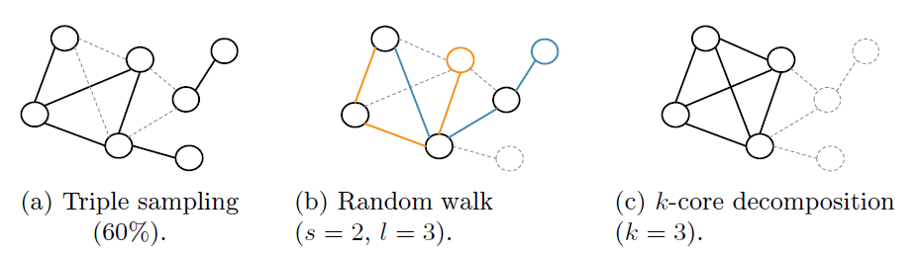
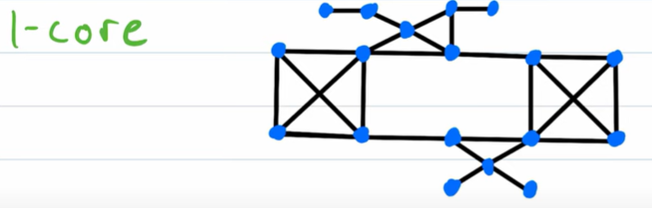
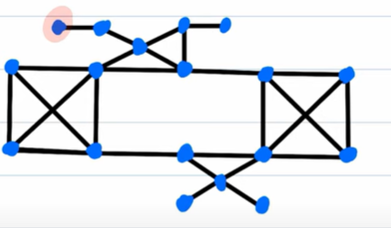
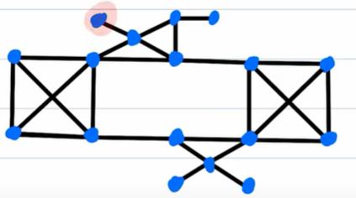
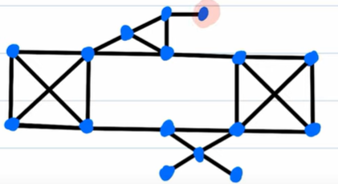
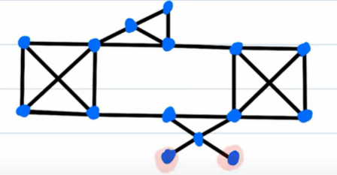
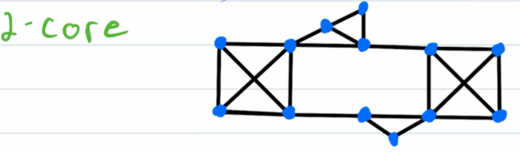
Motivation
Shortage of KGTuner
Fixed heuristics (e.g. 20%/top-10) limits flexibility of
budget allocation on each configuration candidates.
Reduce graph by random walk may lead to underperforming.
Multi-stage fidelity
lower-fidelity → higher-fidelity by successive halving.
Graph reduction: k-core decomposition
Triple sampling: High cost and low transferability
Random walk: Better connected
k-core decomposition: Better connected with cheap computation (O(n))
Combine both graph reduction and epoch reduction
round one
small subgraph
small epochs
round two
medium subgraph
medium epochs
round N
large subgraph
large epochs
Low fidelity
Medium fidelity
High fidelity

Slide 7
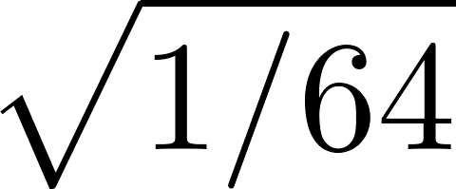
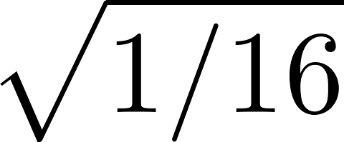
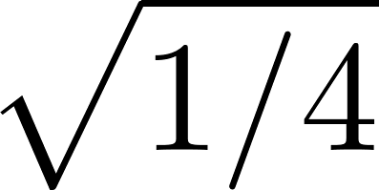
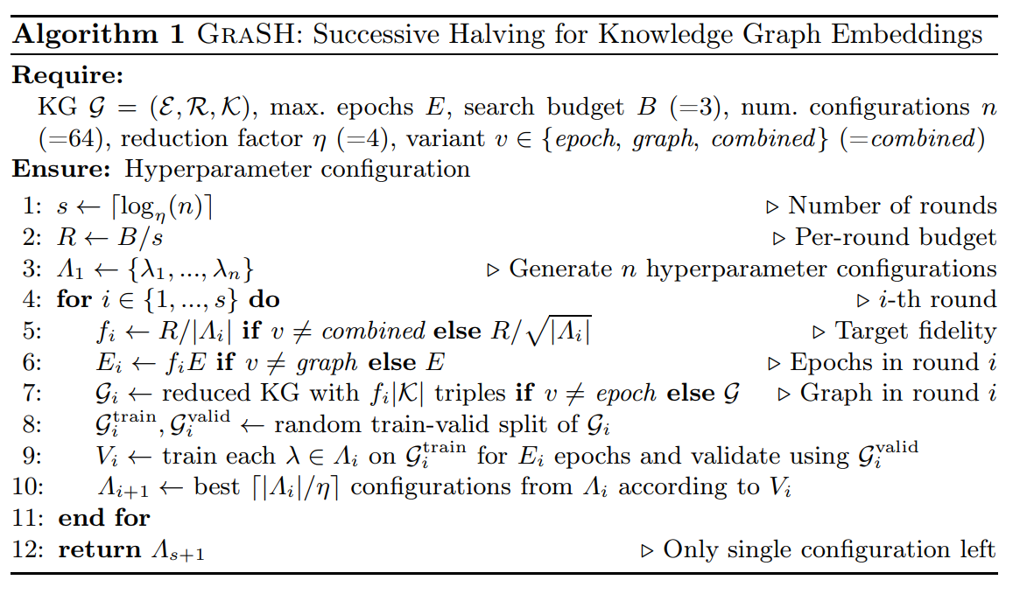
Method
Round num(s) = 3; Per-round budget(R)= 1
Successive Halving for Knowledge Graphs
round 1
fi =
triples
max epochs
round 2
fi =
triples
max epochs
round 3
fi =
triples
max epochs
n = 64
Top 16
Top 4
Top 1
round 1 cost:
round 2 cost:
round 3 cost:
Each round has approximately the same overall budget, but differs in the number of configurations and fidelity.

Slide 8
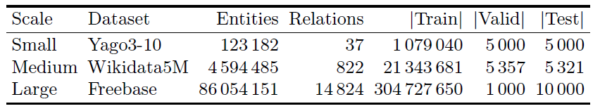
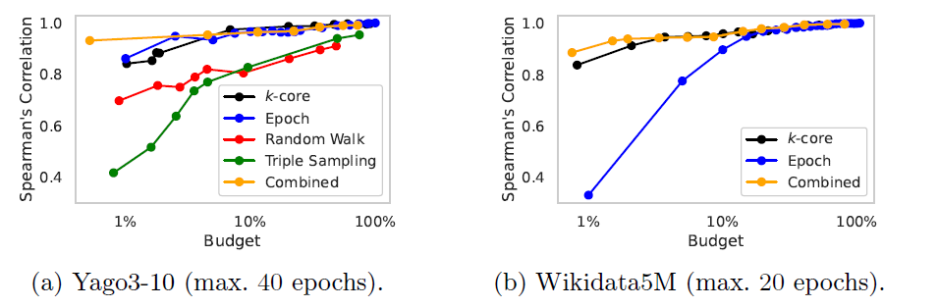
Experiments
Datasets
Models: ComplEX、TransE、RotatE
Experiment I: Different reduction methods
Spearman’s rank correlation coefficient between the low-fidelity and the high-fidelity results (MRR).
k-core is the most efficient among
graph reduction methods.
k-core remove long-tail entities with
infrequent connections and the
left entities are highly interconnected.
Combination of both epoch and
graph reduction perform best.

Slide 9
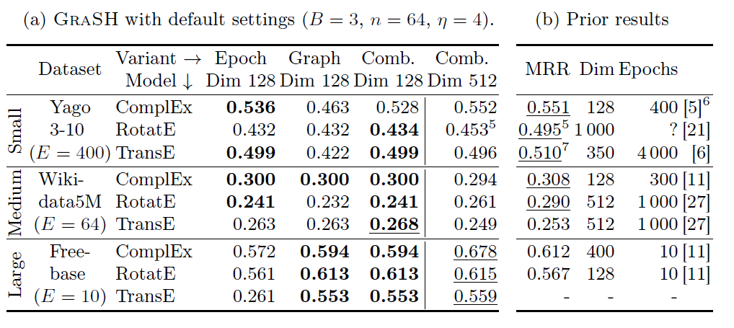
Experiments
Experiment II: compare to prior results
Comb. is the best.
GraSH performed similarly as the best prior results
On the large-scale Freebase KG GraSH outperformed SOTA results.

Slide 10
Experiments
Experiment III: compare to KGTuner
On Yago3-10 with ComplEX (n=50, Epoch max.=50, dim.=1000)
The high computational cost of KGTuner mainly stems from its inflexible and inefficient budget allocation.
The higher quality of GraSH stems from its use of multiple fidelities (vs. two in KGTuner) and by using a combination of k-cores and epoch reduction (vs. random walks in KGTuner).
Methods | Time cost | MRR
KGTuner | 5 days | 0.505
GraSH | 1.5 hours | 0.530

Slide 11
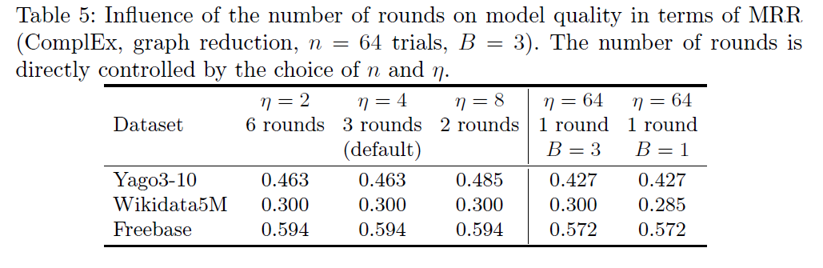
Experiments
Experiment IV: Sensitivity with respect to the number of rounds
Cases of multiple rounds(#≥2) show little difference. The search was robust to changes the number of rounds
Cases between multiple rounds(#≥2) and 1 round show significant difference, which means multiple fidelity levels is essential.

Slide 12
Discussions
Advantages:
Quickly select at the early stage, e.g. 1/64 of full-fidelity cost (GraSH) vs. 20% subgraph (KGTuner), making it possible to apply to large-scale KG.
Multiple-stages method.
Combination of k-core decomposition and epochs reduction.
Disadvantages / Questions:
k value in k-core is discrete, which make it hard to get subgraphs as we want.
Performance of combination method vs. epoch reduction method seems similar.
Comparation to KGTuner seems unfair.

Slide 13
Thanks！

